Slide 1
American Employment data Dashboard

Slide 2
Dashboard Key Points:
Employment Data dashboard covers the employment history of US population from 1950 to 2020.
Data sets are extracted from US Bureau of Labor statistics data base. This data base is prepared as per yearly/Monthly conducted CPS (Current population survey) by US Bureau of Labor statistics.
Total population – The “Total Population” term used in dashboard means civilian noninstitutional population, which refers to people 16 years of age and older residing in the 50 States and the District of Columbia

Slide 3
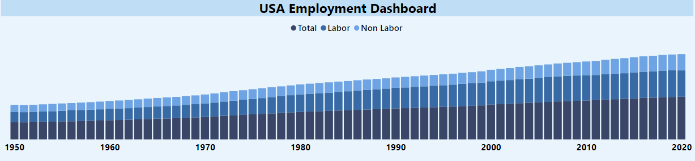
Population Trend - Total vs Labor Vs Non-Labor
The above trends show the increases in Total Noninstitutionalized Population along with increases in Labor and Non labor population.
Overall percentage of labor to total population has been increasing over the years. 1950 percentage was 59.25% whereas in 2020 It grew up to 61.75% . A constant increase trend between 1990 to 2007 also appears.

Slide 4
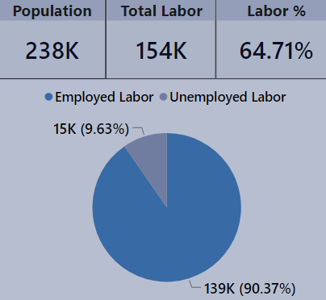
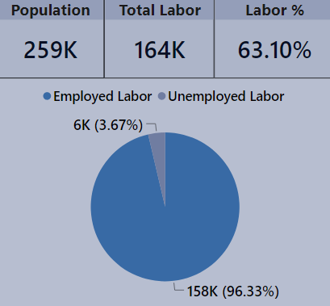
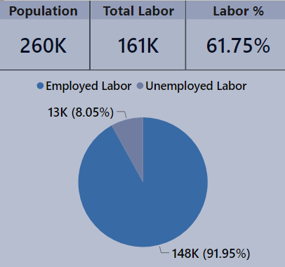
Employment History in Percentage
2010
2019
2020
Employment percentage has declined from 96.33% to 91.95% compared to last years. Whereas it has increased from 90.37% compared to a decade ago.

Slide 5
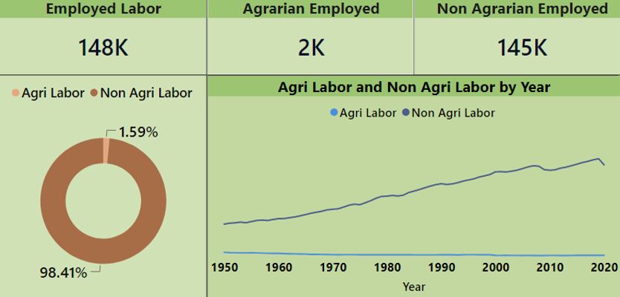
Agrarian to Non-Agrarian Employment 2020
An increasing trend of employment towards Non-Agriculture industry can be seen, whereas agriculture industry employment % has declined over the years.
1950, Agriculture covered 12.15% of employment. 35 years later, It dropped to 2.97% and now again 35 years later in 2020, Agriculture employment is just 1.59%

Slide 6
Few thoughts to leave behind:
Labor % has been constantly increasing from 1990 to 2000. At one point in 2001, It reached 66.82%. Why did rate of increase starting to decline later?
Labor trend has declined from 2019 to 2020 from 63.10 % to 61.75%. How much Covid is the reason for this decline?
Slide 4 says labor % has been increasing and slide 5 says Agriculture employment has been decreasing. Where is the labor going? What other sectors are emerging? Which other sectors the most employment?
Most Important – We know the world population is expanding, and everyone need food. Then how a small section of employment is sustaining such massive population and how much technology is contributing it minimize the Agriculture employment?

Slide 7
Thanks
Ajay Kumar

